Slide 1
Smart ReFlection
Manoj Khatri, Zoya Sheik, Karishma Garikapalli

Slide 2
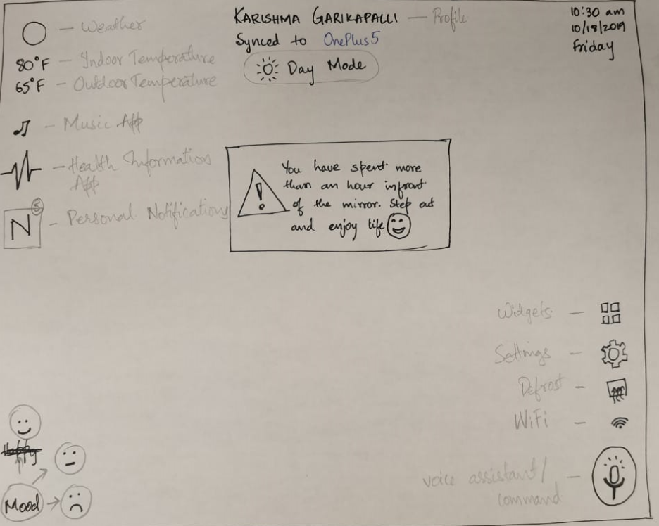

Slide 3
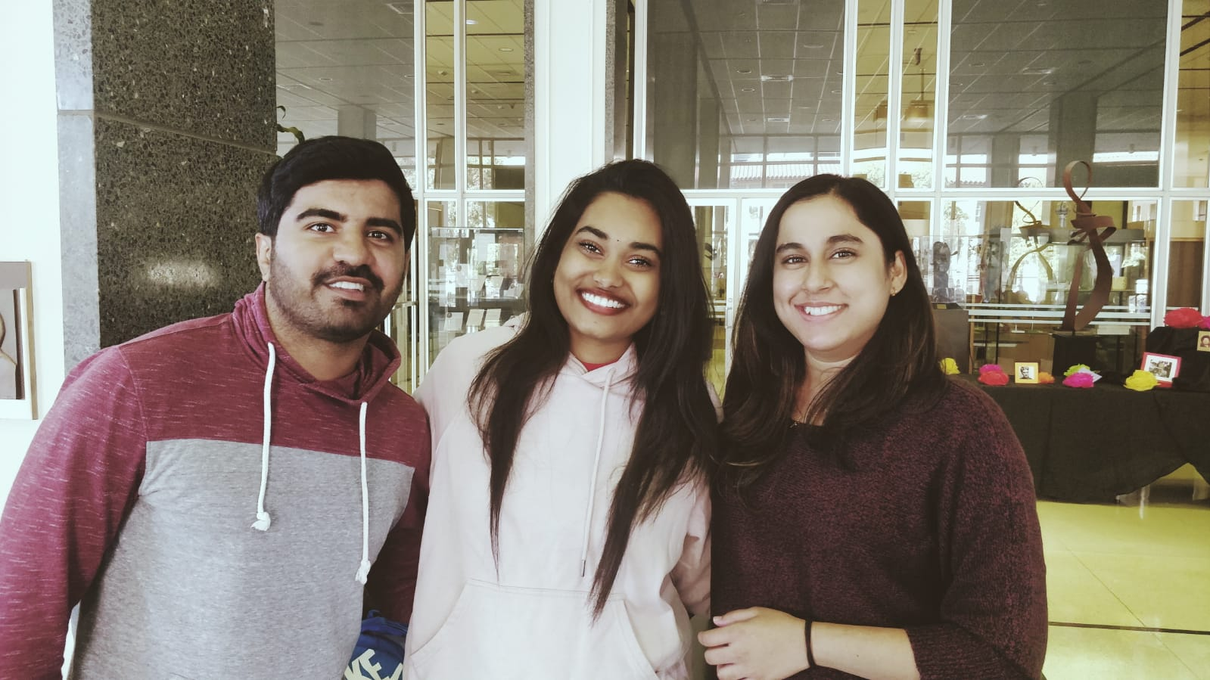

Slide 4
Team member roles
Karishma Garikapalli (Leader) – Facial Recognition and Voice Commands
Manoj Khatri – The side panel with widgets, settings, defrost etc
Zoya Shaikh – Adding all the default features like weather, date, time etc

Slide 5
Login
We plan on using facial recognition algorithm to sign users in, to their profiles
For this proof of concept algorithm so we assume the users have already registered and profile is created

Slide 6
Features
Facial Recognition
Moods
Temperature, Date and Weather info
Music
Personal Notifications

Slide 7
More Feature
Zen Mode
Health Tracking App
Voice Assistant
Voice Commands
Day and Night Modes
Sync to Phone

